Slide 1

Indian Bank Loan Analysis - D4
Master in Data Science
UPC BarcelonaTech - FIB
2023-2024 Q1
Multivariate Analysis
Tuesday 16th, 2024
Group 11
Casanova Lloveras, Adrià
Chimeno Sarabia, Alícia
García Pizarro, Víctor
Giurcoiu, Victor-George
Ji, Zhengyong

Slide 2
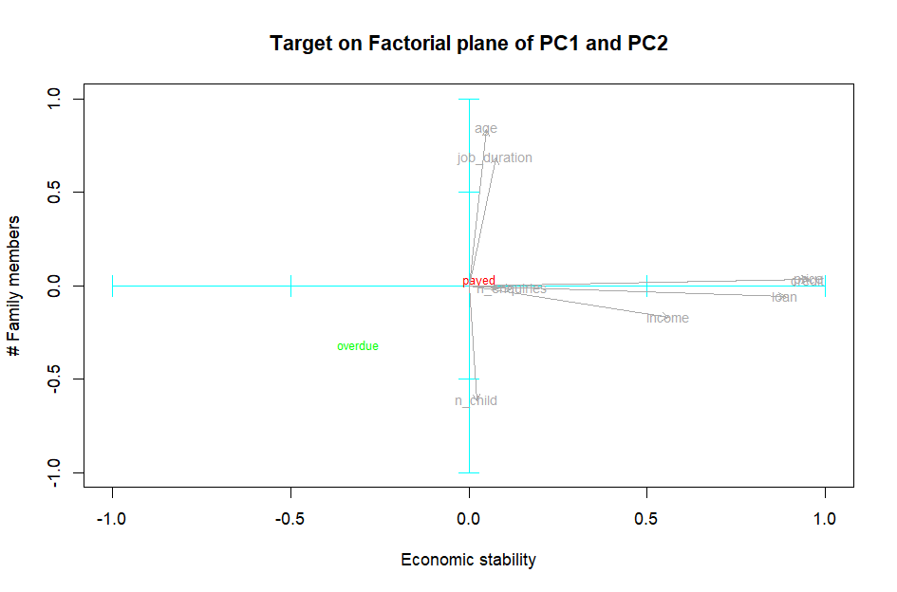
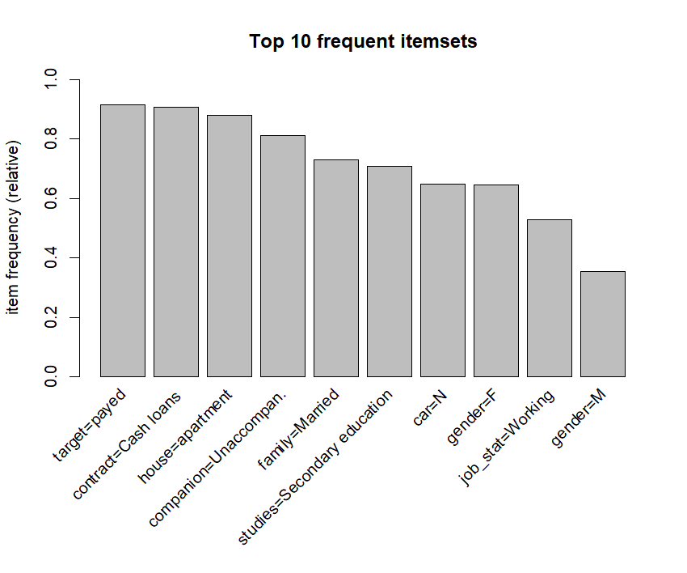
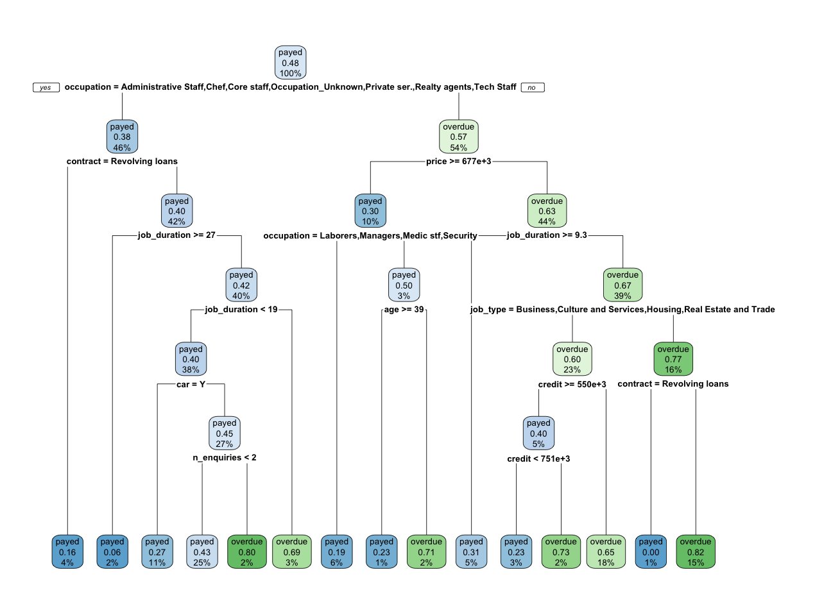
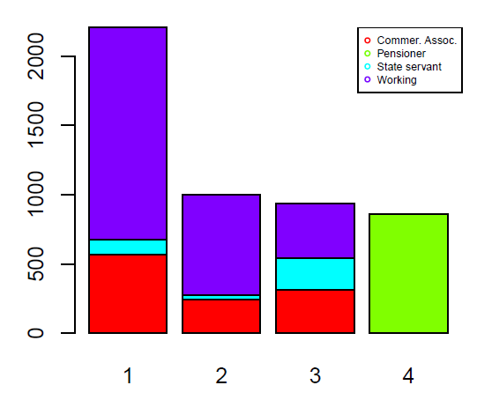
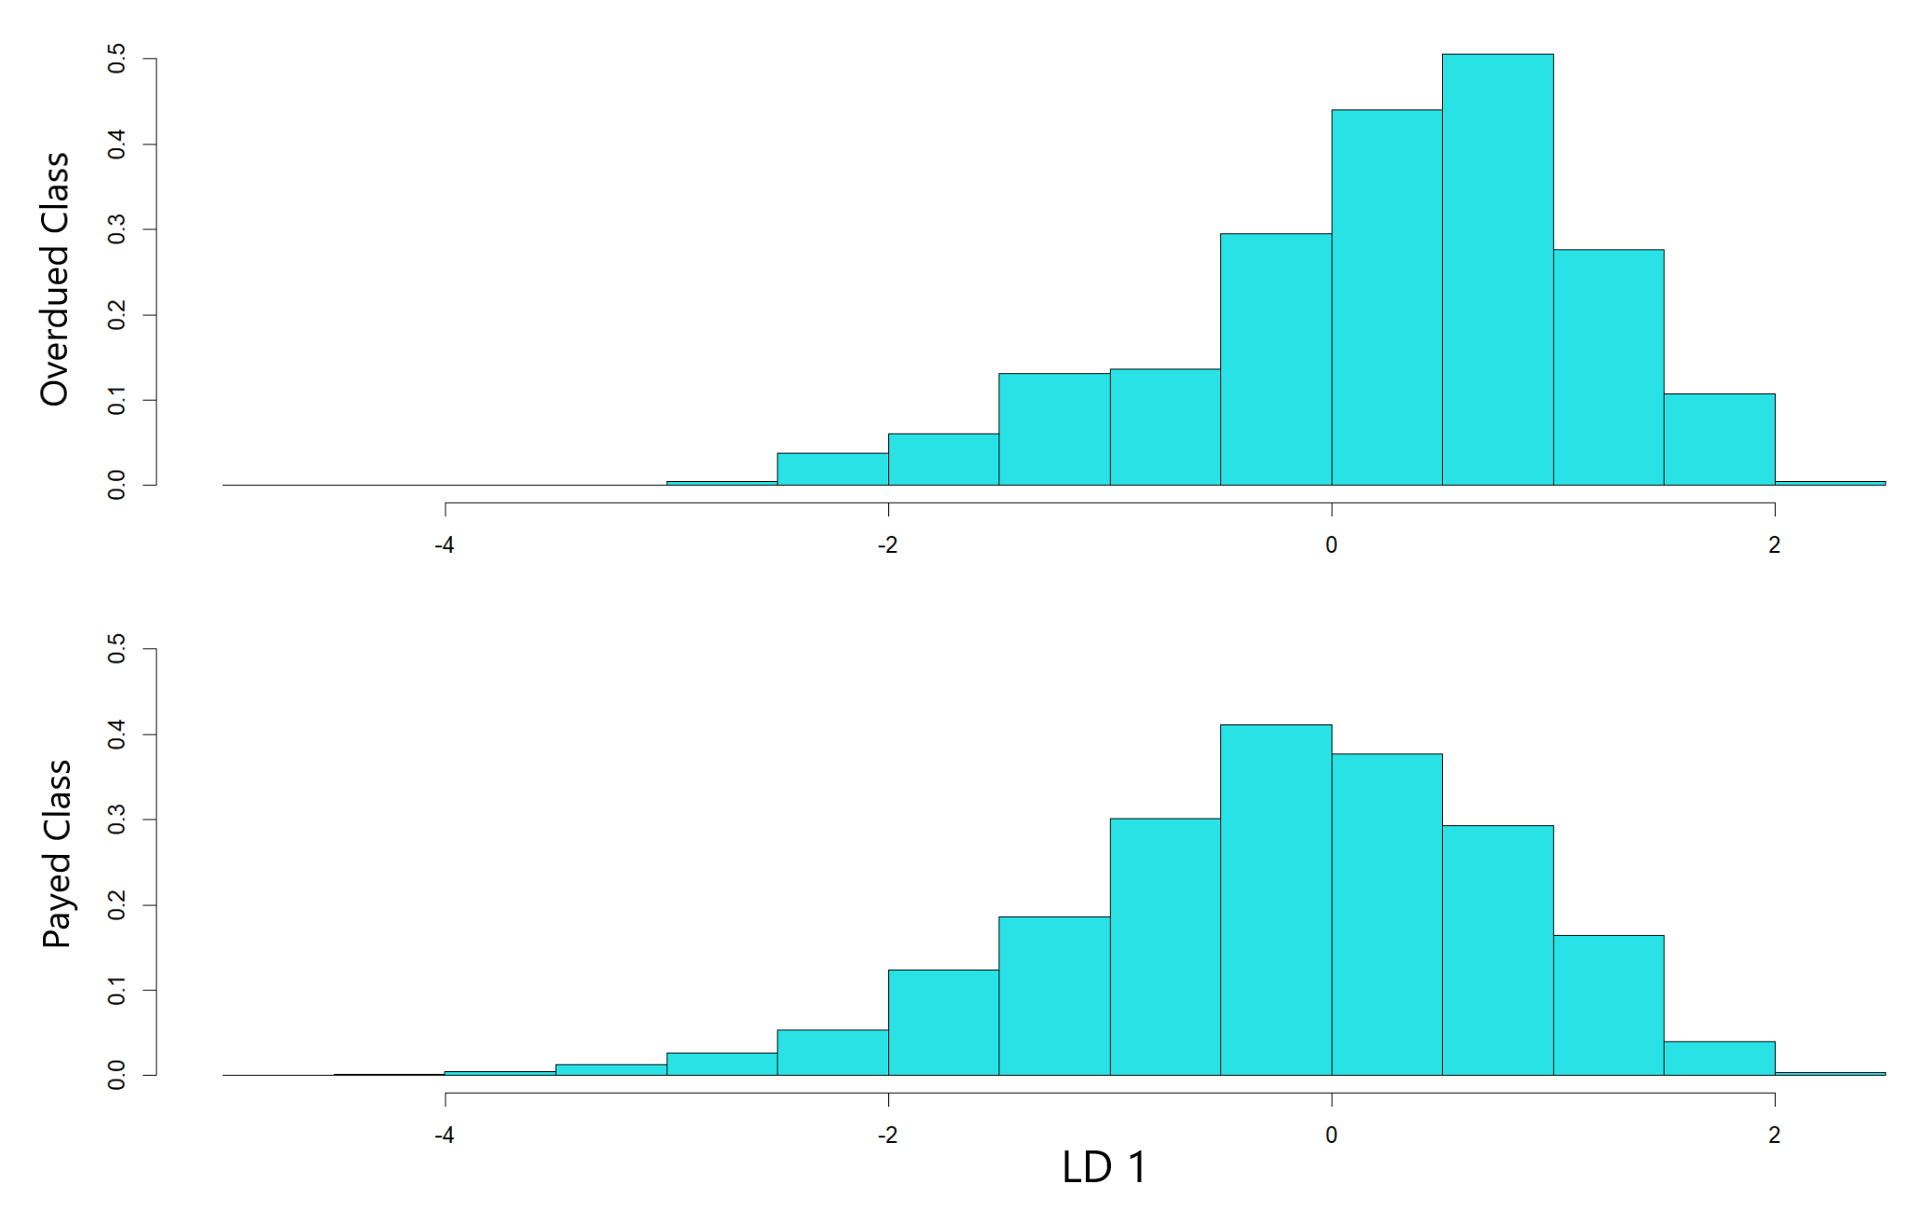
Table of Contents
01
02
03
04
05
Previous work
Association Rules
Decision Trees
Clustering & Profiling
LDA
EDA, Preprocessing, PCA, MCA
Itemset & rules extracted
Paths, dichotomies & insights
Hierarchical,
k = 3, 4
Linear Discriminant Analysis

Slide 3
1.
Previous Work
EDA, Preprocessing, PCA, MCA

Slide 4
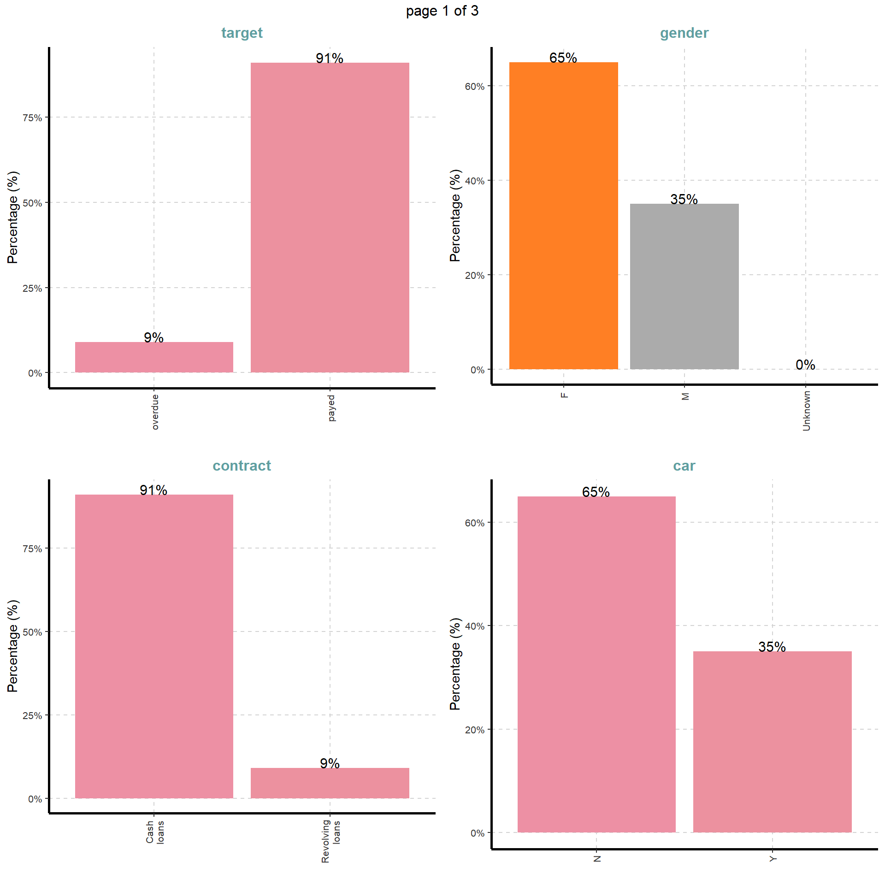
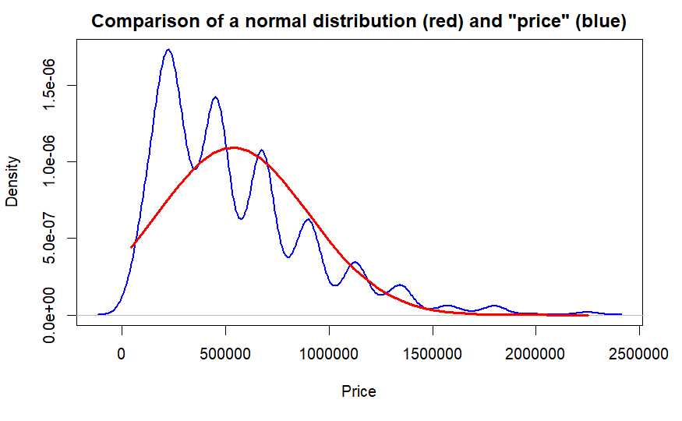
EDA
Distributions of numeric variables are not normal
Sample is highly unbalanced, specially in the target variable
Notes:
Victor Garcia
Presentation: our database is about loan, target variable is if people pay or not the loan.
EDA: Not normal distribution and sample is unbalanced

Slide 5
Preprocessing
-Create shorter names for categories and variables
-Transformations: age transformed from negative days to years
-Dealing with missing data
-Qualitative: Creation of a new category ““Variablename_Unknown”
-Numeric: Assumed missing at random and impute (MICE)
-Outlier detection: We decided to keep them
Notes:
Victor Garcia

Slide 6
PCA

Slide 7
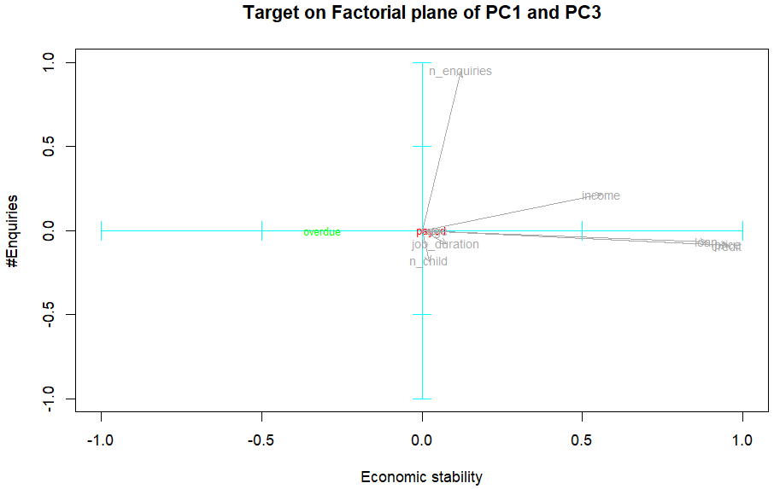
PCA

Slide 8
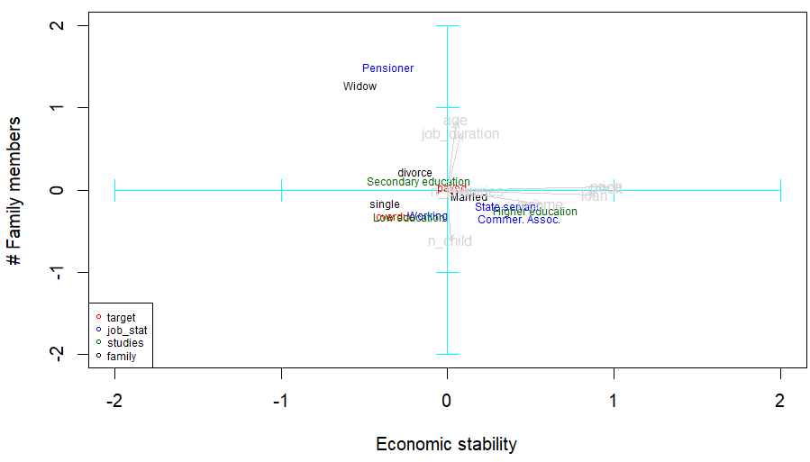
Paid on time => married or divorced and have a secondary education
Payment delayed => single, with a low education and don’t work for the state nor in commerce

Slide 9
PCA
We would suggest the bank manager to be careful when giving loans to:
single clients
who are laborers
with a low education
and live in office apartments
Notes:
We would suggest the bank manager to be careful when giving loans to:
single clients
who are laborers
with a low education
and live in office apartments

Slide 10
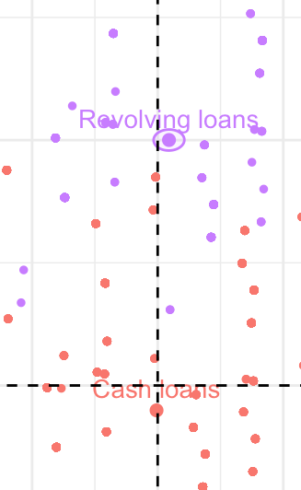
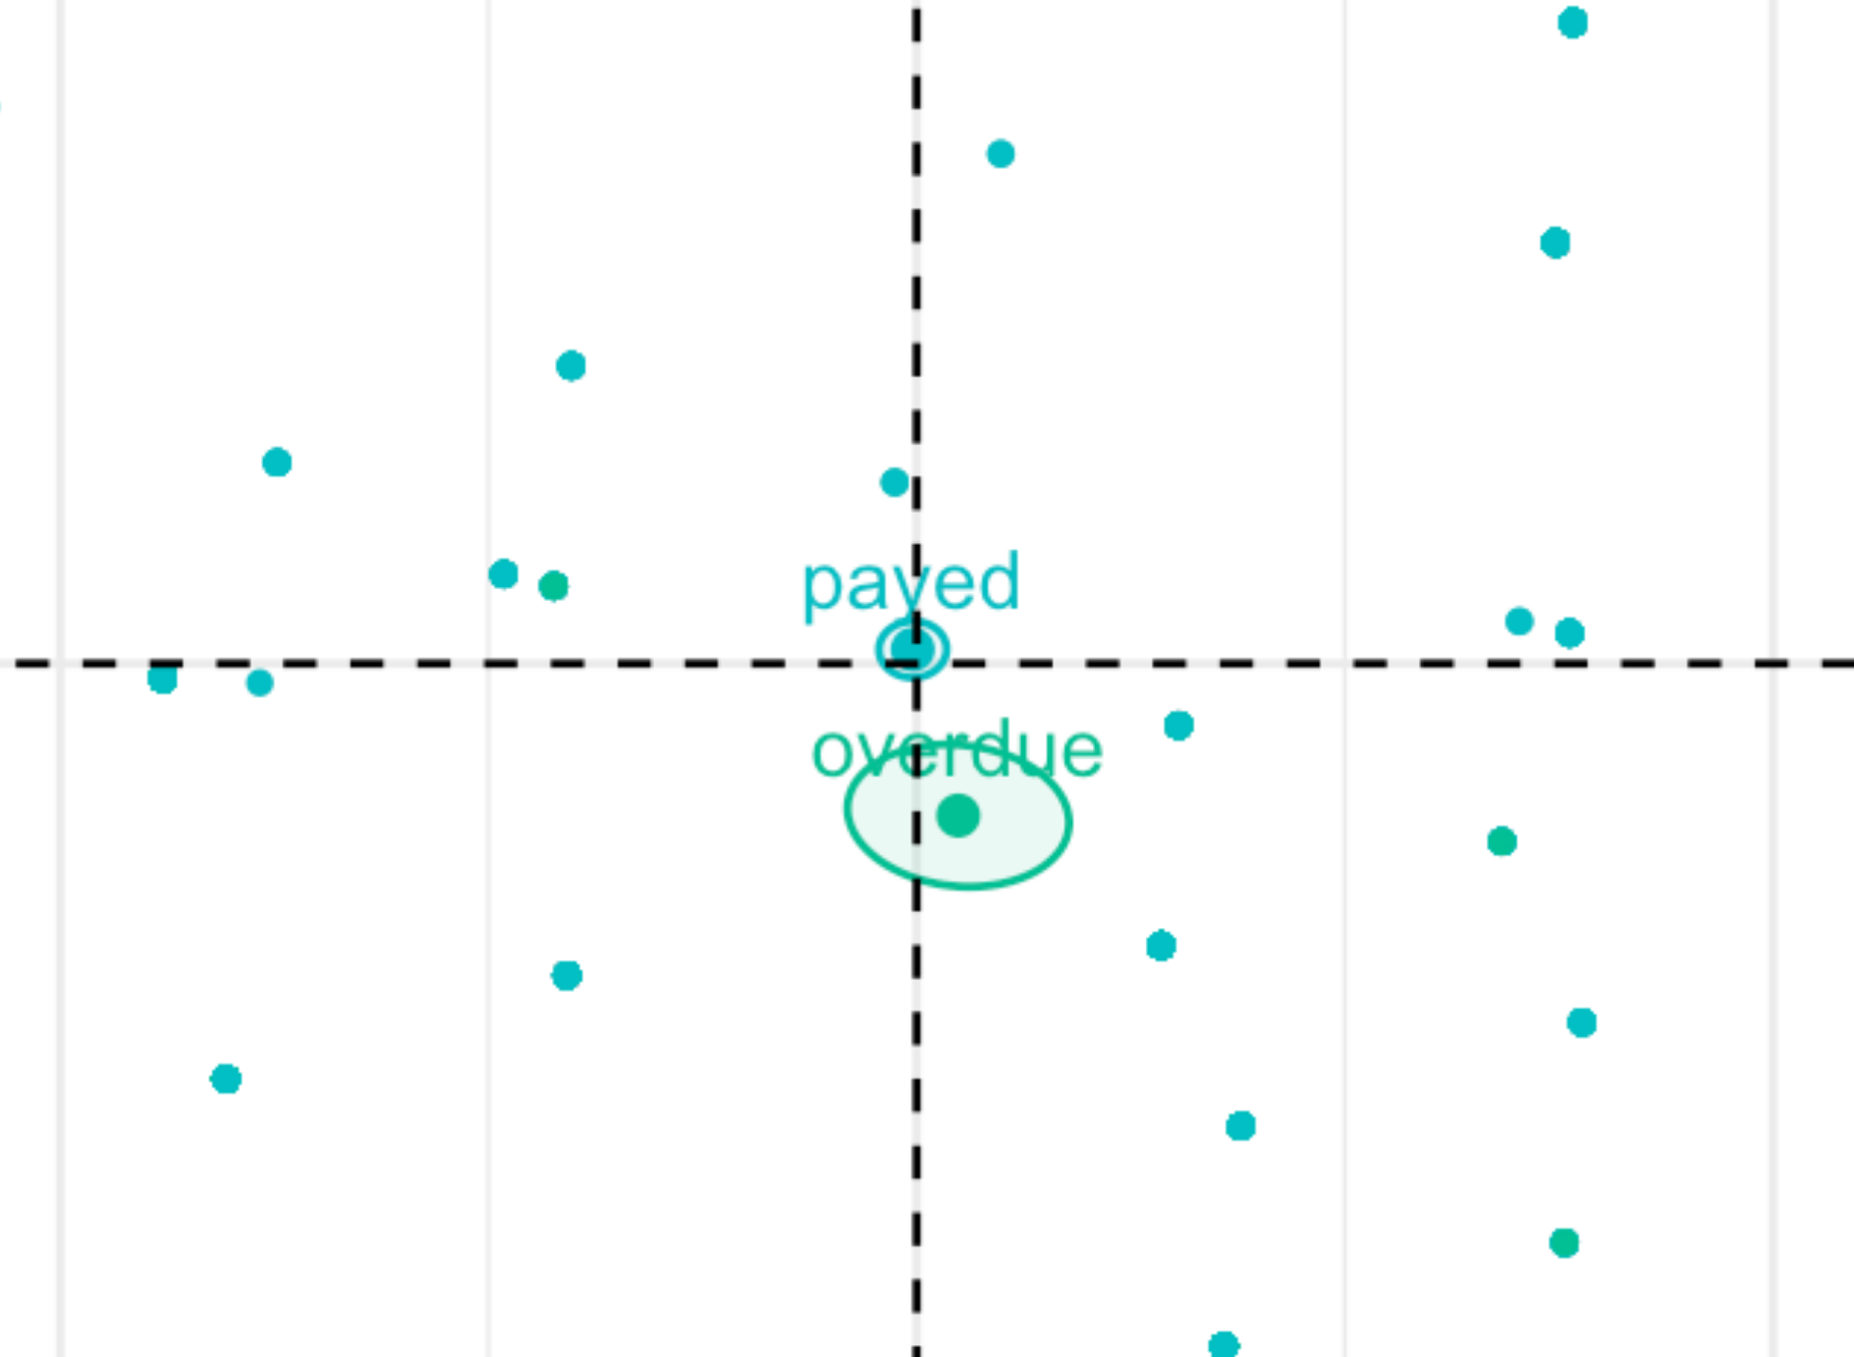
MCA
Revolving loan
Cash loan

Slide 11
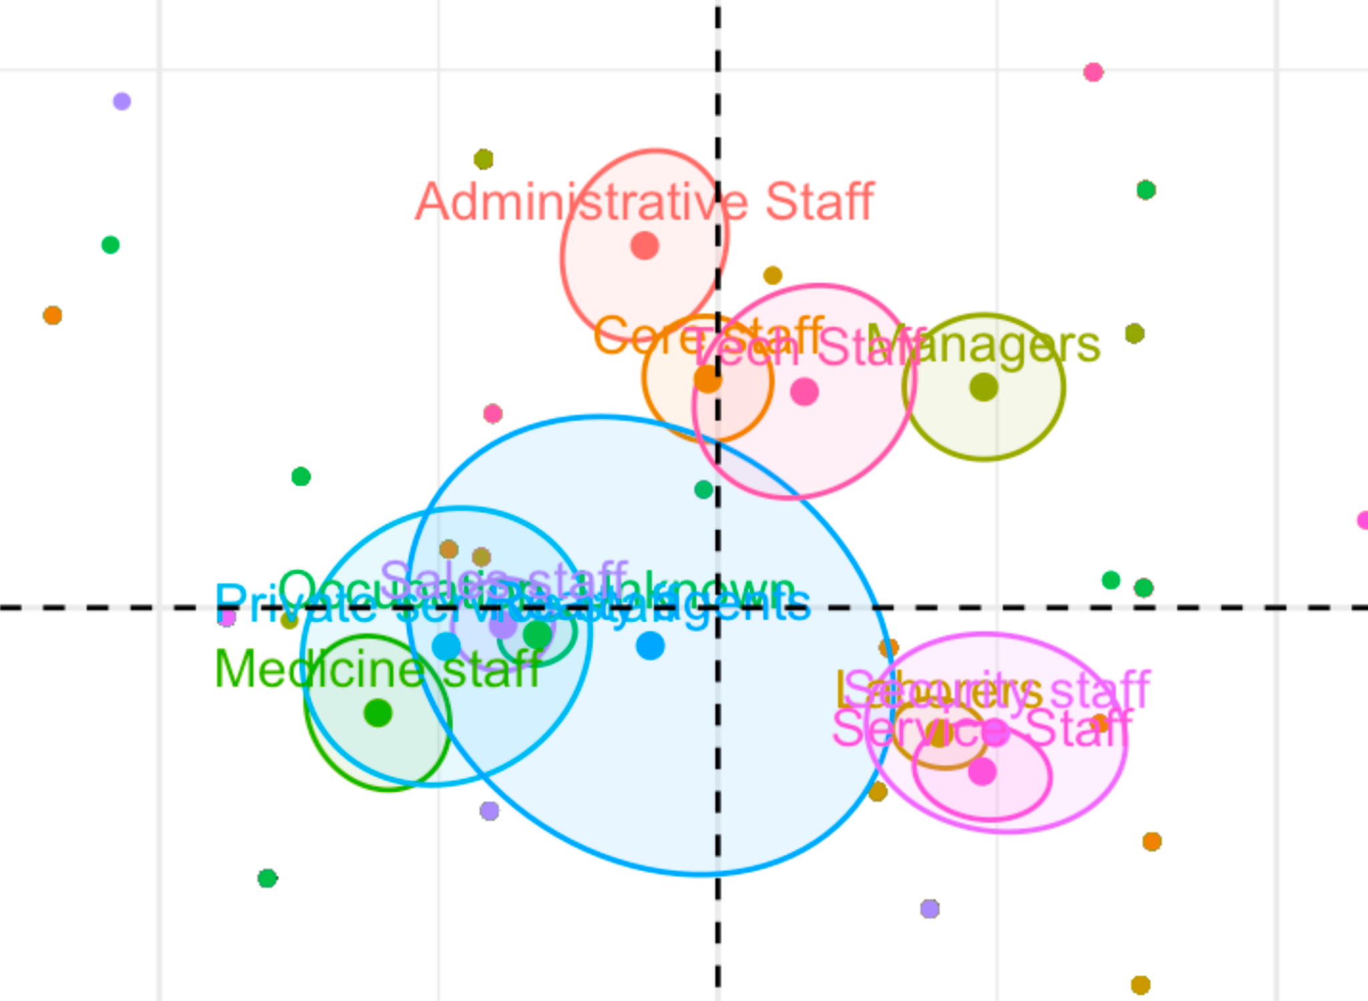
MCA
Administrative, Managers, Core Staff, Tech staff
Service, Security, Laborers
payed
overdue

Slide 12
MCA
We would recommend the bank manager to watch out for people who:
work on security, on services or as laborers
ask for a cash loan
On PCA as well!!

Slide 13
2.
Association Rules
Itemset & rules extracted
Notes:
Victor Garcia

Slide 14
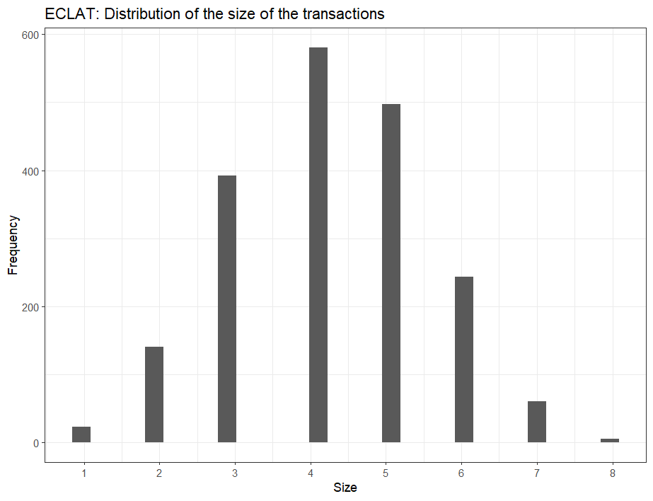
Analysis of the itemset
-62 items but most frequent itemsets are related to loan (90% is payed and of type “cash”).
-Transactions have between 1 and 8 items
Notes:
Victor Garcia

Slide 15
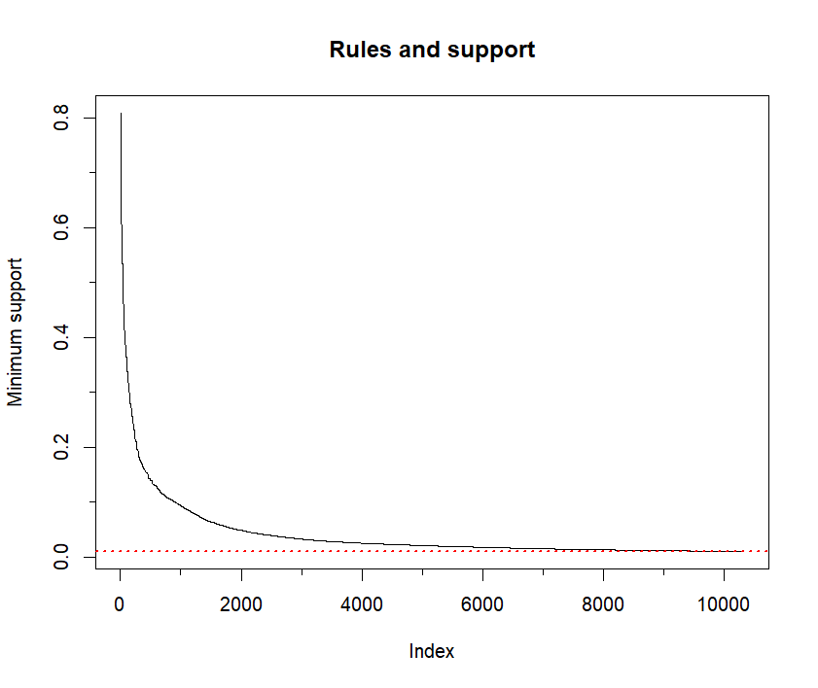
2) Definition of ‘good rule’ criteria
What makes a good rule?
Confidence | 0.7
Minimum support | 0.01
Lift | >= 3
Non redundant and useful to extract knowledge
0.01
We obtained 85 rules
Notes:
Victor Garcia

Slide 16
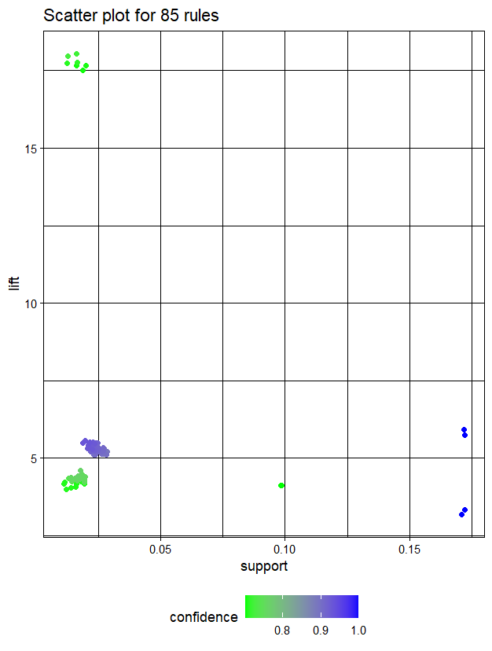
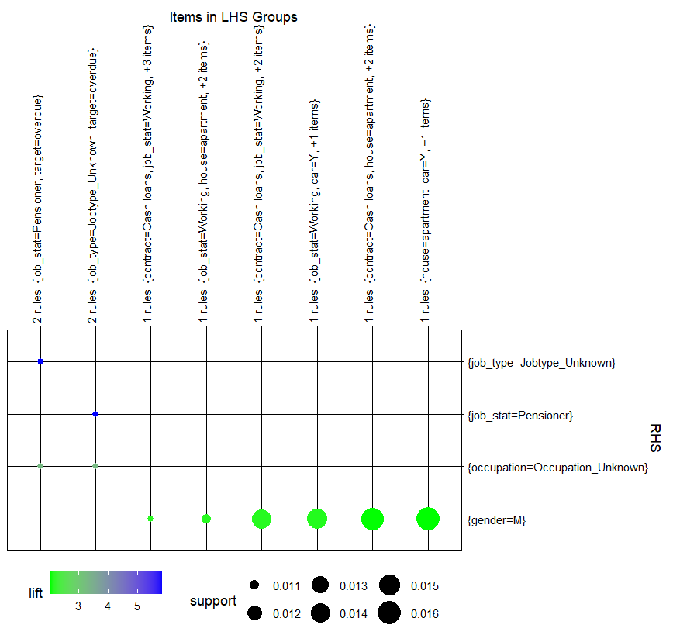
Best rules
TRIVIAL RULES
Conclusions
1) All “job_type = pensioners” have “occupation = unknown occupation”
2) Most relevant rules were related to gender and described characteristics that we already knew.
Perfect confidence
Notes:
Victor Garcia

Slide 17
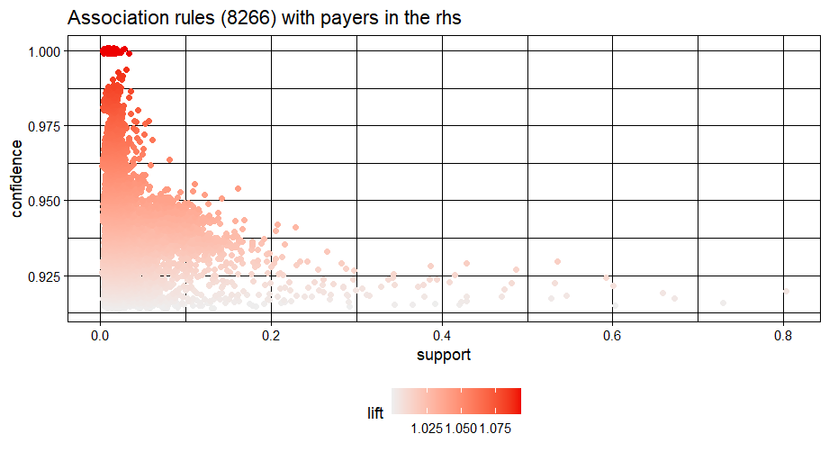
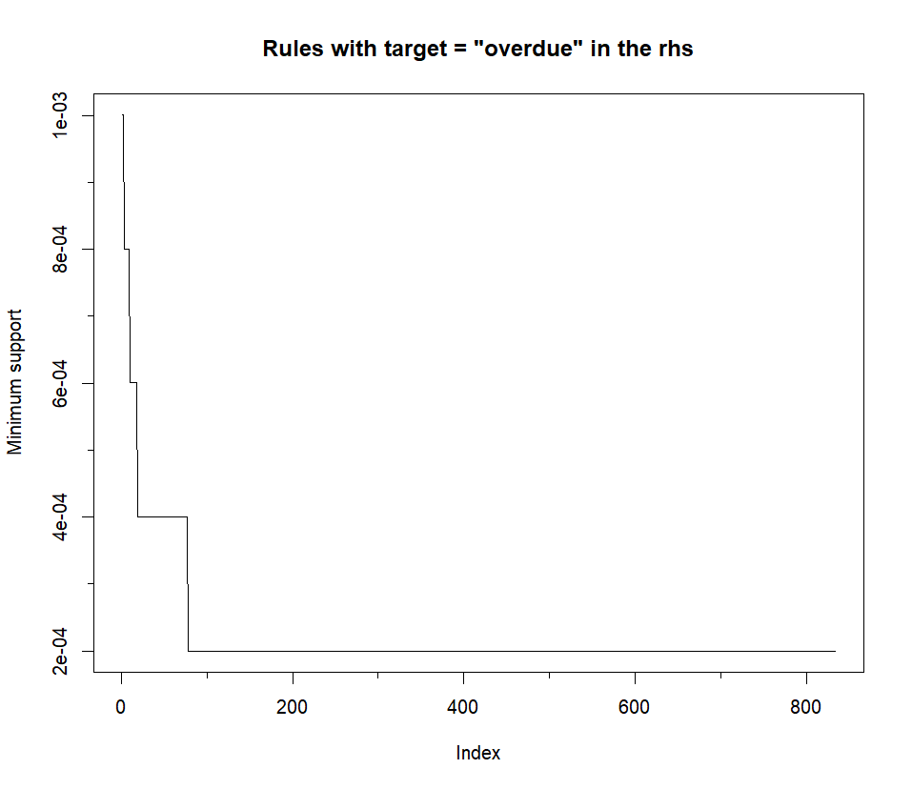
3) What did we learn from the target?
No rules with target = ‘overdue’
With target = ‘payers’ we did not find any good rules as lift too low
Notes:
Victor Garcia

Slide 18
3.
Decision Trees

Slide 19

Decision Trees
Better explicability
Recall: The target variable is
Categorical (paid/overdue) -> Classification tree
Highly unbalanced 91’4% vs 8’6%-> Performed a balancing task
To obtain the best decision tree, we must fine tune the the following hyperparameters: cp, maxdepth, minsplit, minbucket.

Slide 20
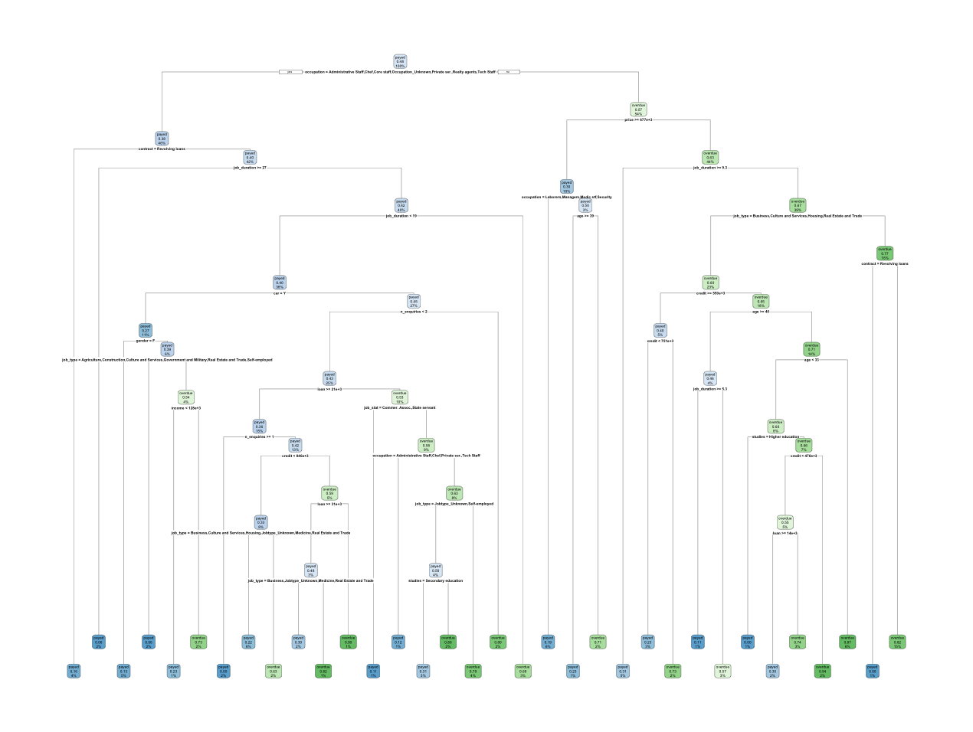
First Decision Tree
Cp fine-tuned
Pure nodes

Slide 21
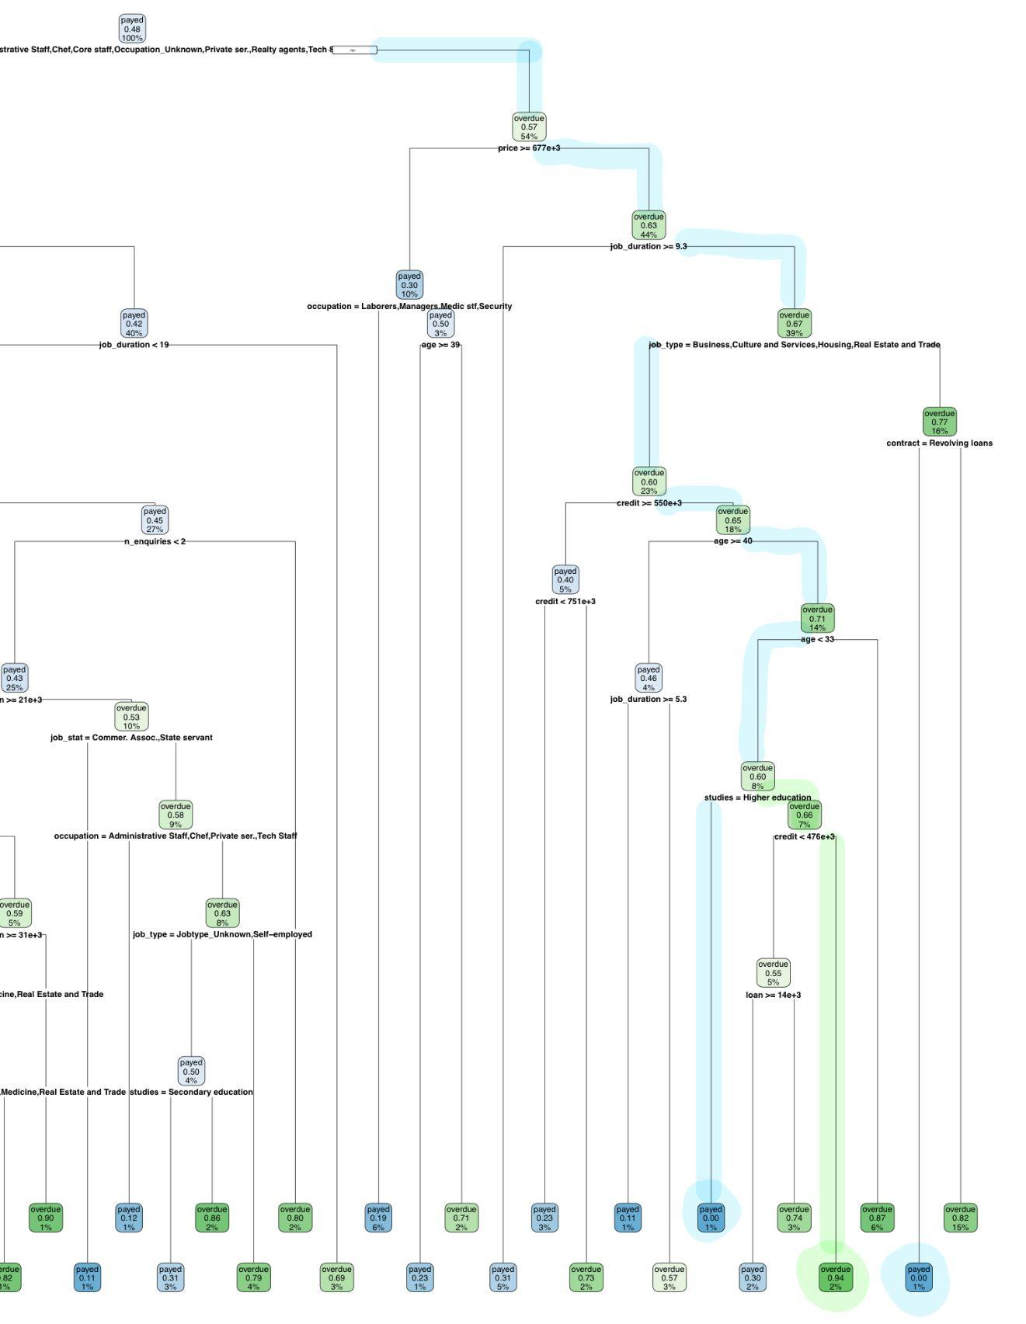
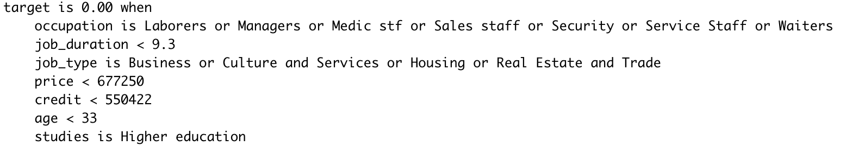
Interesting paths (100% pure)
Will pay the loan on time
DESCRIPTION
Young
High education
Business sector
Low job duration
Substantial bank savings
Lower amount asked than in his savings

Slide 22
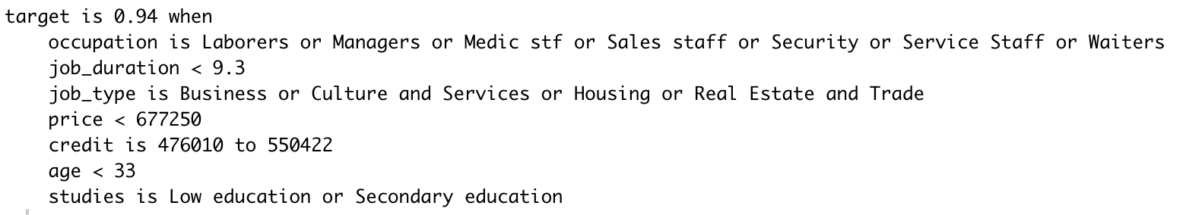
Interesting paths
Will not pay the loan on time
DESCRIPTION
Young
Low or Secondary Education
Service employee
Low time on their job
Less savings than money of the loan

Slide 23
Predictive power of the decision tree
Accuracy
Train | Test
79.4 | 64
Overfitting?
Prune the tree
Fine-tune maxdepth
maxdepth=6

Slide 24
Pruned Decision tree
Avoid overfitting
More general tree
Better explicability
Lower % purity in terminal nodes.
Accuracy
Train | Test
70 | 69

Slide 25
Interesting insights
We have found several paths that are 100% accurate.
Young, rich business people applying for a loan that is less than 25% of their savings always pay the loan on time.
Service employees with low time on their job, low education that have less savings than the amount they ask for the loan are predicted to not pay the loan on time.
Decision trees may not be the best model to make predictions but
Have high explicability. Is not a black box.
Can predict with high confidence rare / not very frequent groups of individuals.
It is remarkably interesting to use decision trees in loan decisions, when you ask for a loan and it is rejected, the bank has to tell you why they didn't conceive you the loan.

Slide 26
4.
Hierarchical Clustering & Profiling
Notes:
Victor

Slide 27
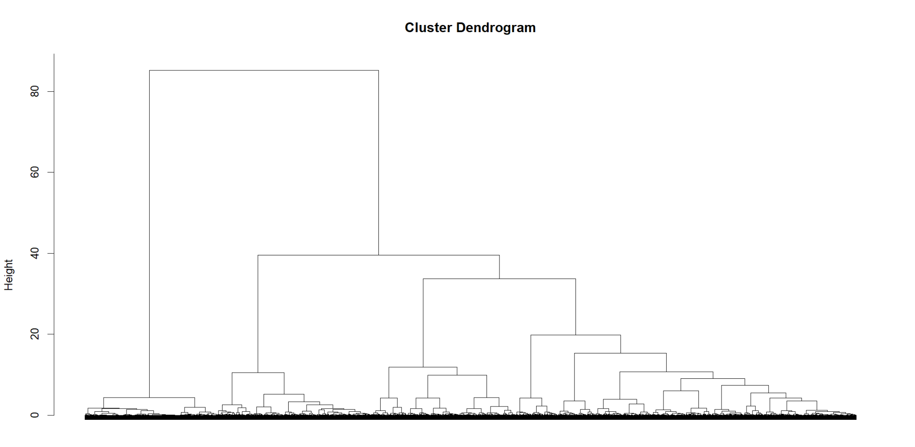
Hierarchical Clustering
Used all variables
Gower distance
Ward’s method
Highest linkage height k=2
Loss of information for k=2
=> k=3, k=4
Notes:
Victor

Slide 28
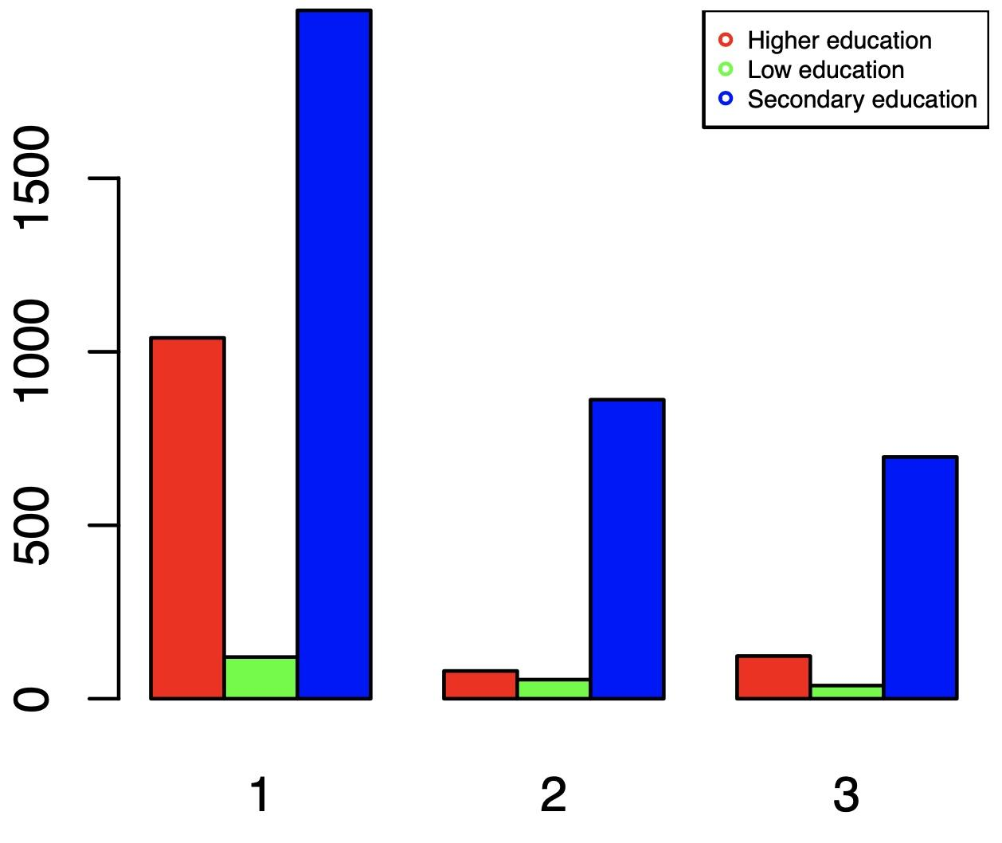
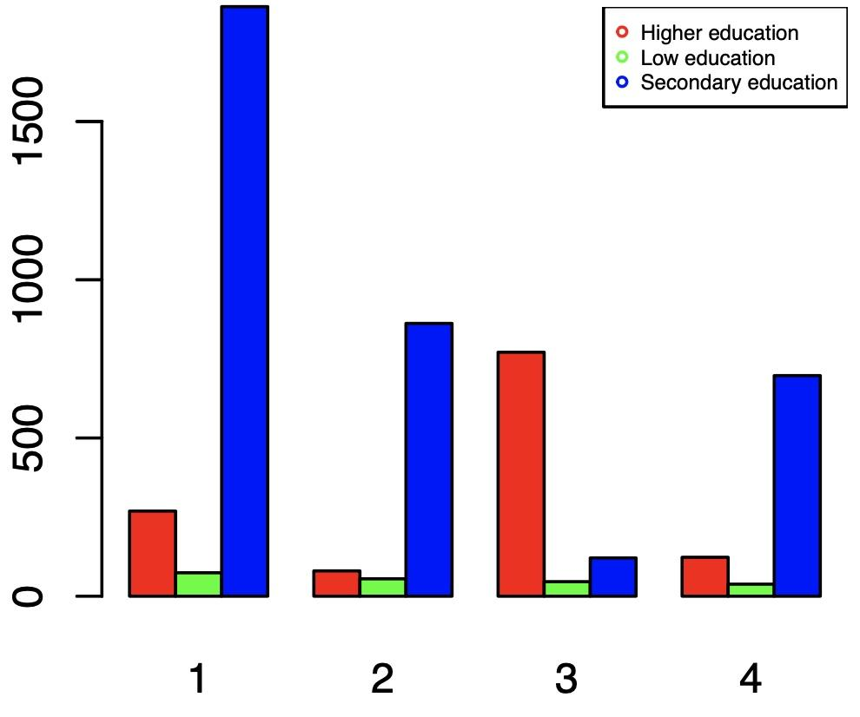
Comparison studies variable k=3 VS k=4
Cluster 1 (k=3) divided into clusters 1 + 3 (k=4)
Cluster 3: higher educated individuals
Notes:
Victor

Slide 29
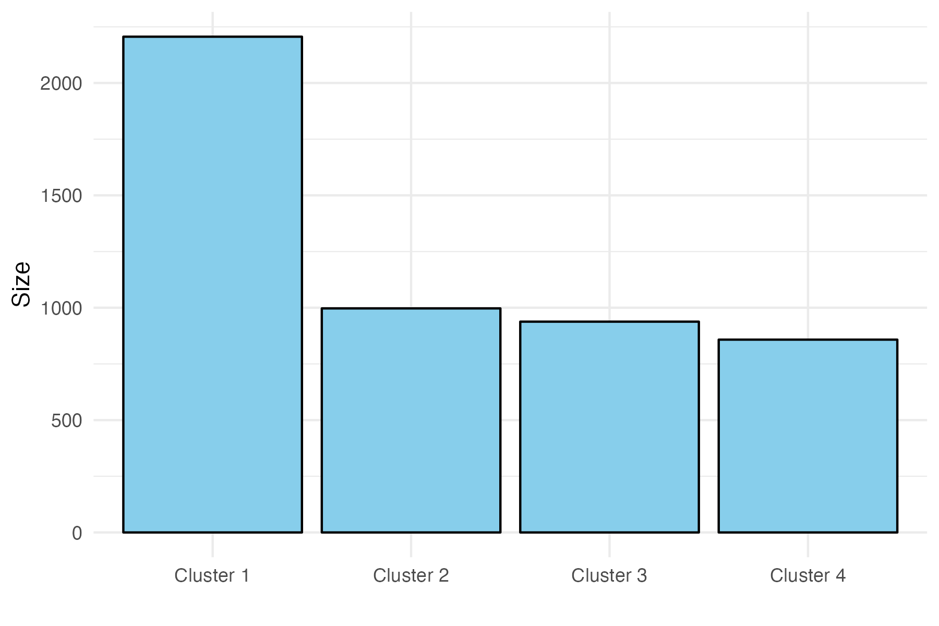
Cluster sizes for k=4
Clusters 2, 3, 4 are of equal size
Qualitative variables: Chi Square test
Numerical variables: Kruskal-Wallis test
All p-values significantly low
Chose variables with significant differences among the clusters (plots)
Notes:
Victor

Slide 30
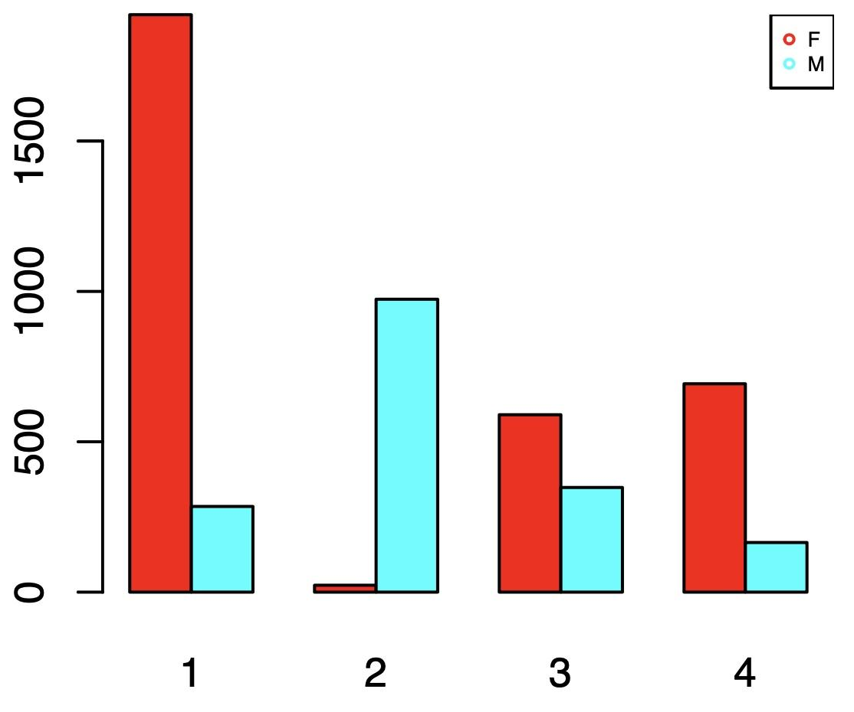
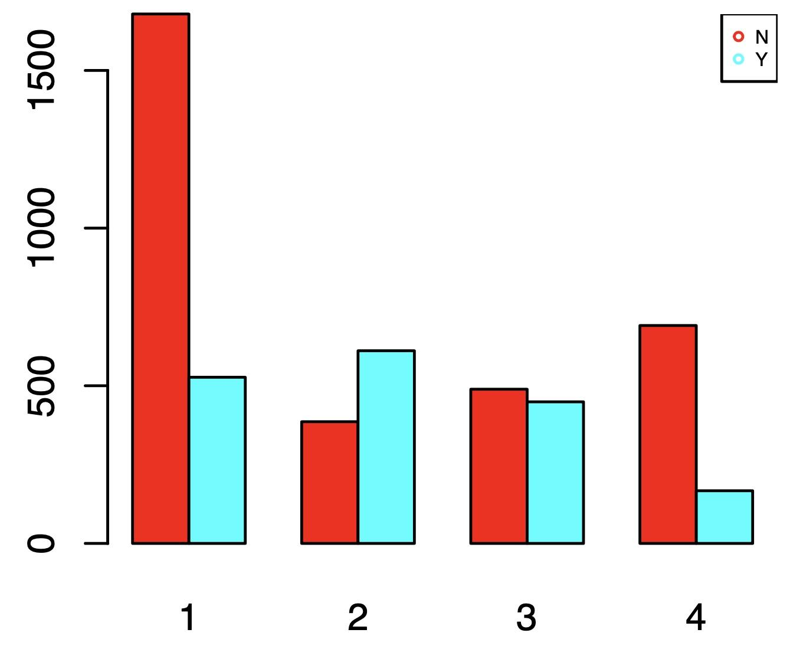
Gender and Car Distributions
Clusters 1, 4: mostly women who do not own a car
Cluster 2: mostly men who own a car
Notes:
Victor

Slide 31
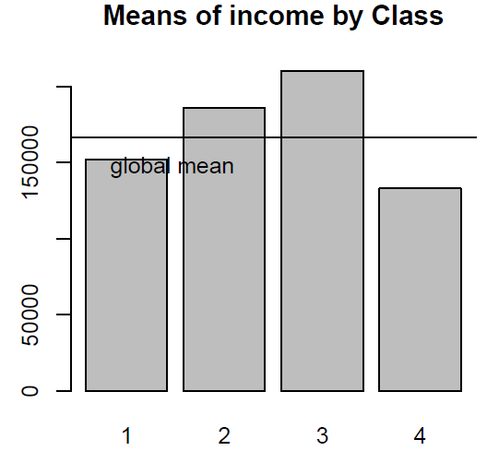
Cluster income level and Job Status
Job status (commercial, pensioneer, state servant, Working) | 568 | 245 | 313 | 0
 | 1 | 0 | 0 | 858
 | 107 | 28 | 232 | 0
 | 1530 | 724 | 393 | 0
Income (mean) | 152103 | 185769 | 210535 | 133146
Notes:
ji

Slide 32
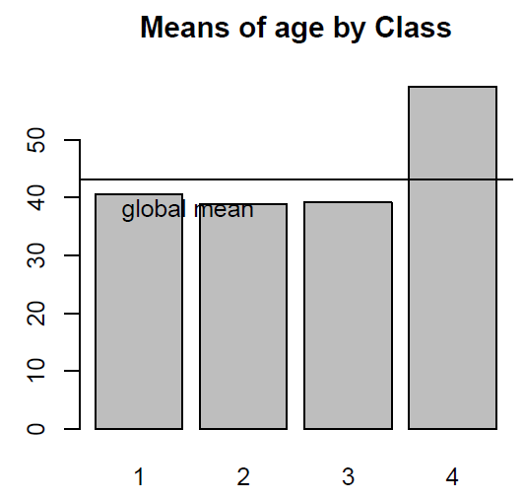
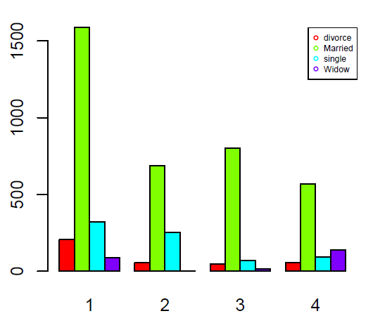
Age and Family status
Age (year, mean) | 40.59 | 38.81 | 39.17 | 59.25
Notes:
Ji

Slide 33
Summary of cluster k = 4
Class | Description of the Class | Subjective Business Suggestion
C 1 | Biggest cluster size, composed mostly women with relatively low income and low education level. | Be careful with accepting the application.
C 2 | Mostly men with the second highest mean income and low education level. But they are reliable by returning the loan. | High-quality client and reliable to return the loan.
C 3 | Cluster with highest income and highest education level. Occupation types are mostly related to high prestige jobs. | High-value clients, but are not very punctual with payment.
C 4 | Oldest people with lowest income and are innestable. Mostly women composed by retired pensioners. | Low-value clients. DO NOT recommend a high value loan.
Notes:
Ji

Slide 34
5.
LDA
Linear Discriminant Analysis
Notes:
Ji

Slide 35
Linear Discriminant Analysis
 | Predicted Class
Actual class | Class | Payed | Overdue
 | Overdue | 140 | 287
 | Payed | 2485 | 2087
Notes:
Ji

Slide 36
6.
Conclusions

Slide 37


Accept the loan
PCA
Decision Trees
Description
Married or divorced clients
Live in standard or municipal apartments
Medic staff and chefs
Unaccompanied or with their families
Description
Young
High education
Business sector
Substantial bank savings
Lower amount asked than in his savings
Association Rules
Ø
LDA
Ø
Profiling & Clustering
MCA
Description
Men
High income
High education
Description
Administrative, Managers, Core Staff, Tech staff

Slide 38

Decline the loan
PCA
Decision Trees
Description
Single clients
Laborers
Low education
Live in office apartments
Description
Service employees
Low time on their job
Revolving loan < 677K
Association Rules
Ø
LDA
Ø
Profiling & Clustering
Description
Single
No car
Low income and education
Occupations in service field (Sales, Laborer...)
MCA
Description
Service, Security, Laborers

Slide 39
Thanks!
Any questions?

Slide 40
Accept the loan
PCA
Decision Trees
Description
Married or divorced clients
Live in standard or municipal apartments
Medic staff and chefs
Unaccompanied or with their families
Description
Young
High education
Business sector
Substantial bank savings
Lower amount asked than in his savings
Association Rules
Ø
Profiling & Clustering
Ø
MCA
LDA
Ø
Description
Administrative, Managers, Core Staff, Tech staff

Slide 41
Decline the loan
PCA
Decision Trees
Description
Single clients
Laborers
Low education
Live in office apartments
Description
Service employees
Low time on their job
Revolving loan < 677K
Association Rules
Ø
Profiling & Clustering
Ø
MCA
Description
Service, Security, Laborers
LDA
Ø

